Slide 1

WELCOME
steps
MUSIC WITH US
Project
services
teams
timeline
about
DESIGNED BY PRASHANT & ADITYA

Slide 2

Project
teams
steps
services
timeline
Main
SUBMITTED BY
PRASHANT KAUSHIK (201500504)
ADITYA SHARMA (201500040)

Slide 3
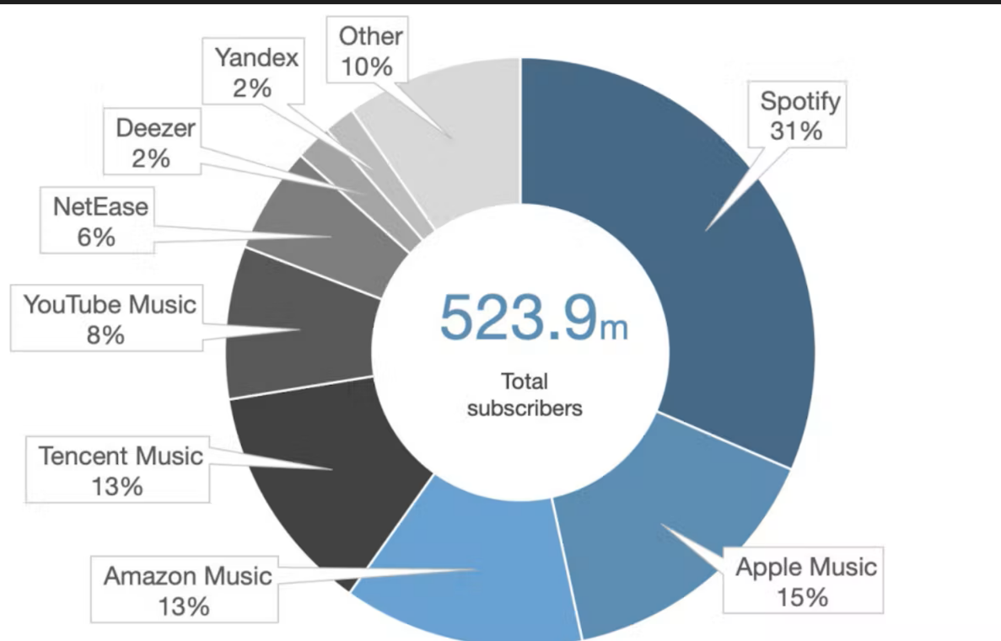
MARKET VALUE

Slide 4



STEP
STEP
STEP
1
2
3
Project
LOGIN
REQUEST
ACCESS
steps
services
teams
timeline
main
Users can fill the login details can enter the music website.
Music as per the need can be found by the user at the site.
Music is all yours.Enjoy it free of cost !!

Slide 6
Project
steps
services
teams
timeline
main
SEP,2022
OCT,2022
NOV,2022
PLANNING
PREPARATION
IMPLEMENTATION
IN THE SEP MONTH WE MADE OUR GROUP OF 2,THEN WE DECIDED TO DO THIS PROJECT TOGETHER
AFTER OUR EXAMS,WE START PREPARAING FOR THIS PROJECT
NOW HERE WE ARE WITH OUR PROJECT DONE AND IN FUTURE WE WILL TRY TO TAKE IT ON LARGE SCALE

Slide 7
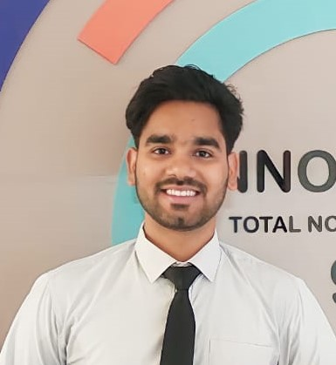
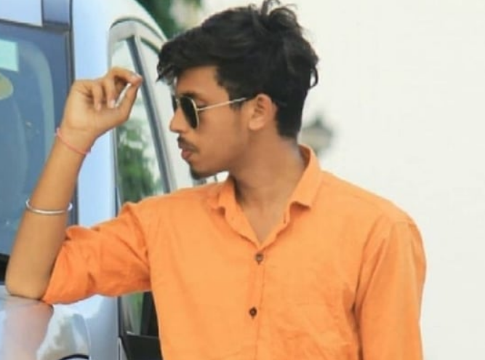
2
01
02
Project
steps
services
teams
timeline
main
PRASHANT KAUSHIK
ADITYA SHARMA
PROJECT MEMBER
PROJECT MEMBER
THIRD YEAR , SEC-B
THIRD YEAR , SEC-C

Slide 8
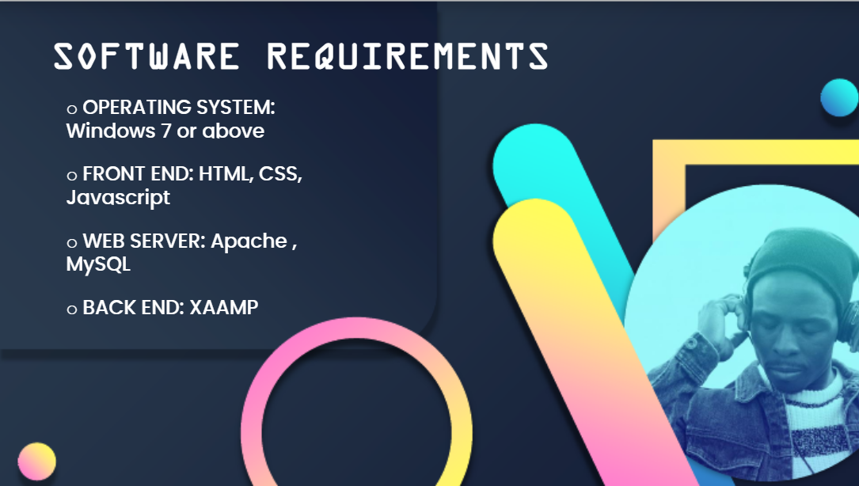

REQUIREMENTS
BACK END : PHP

Slide 9
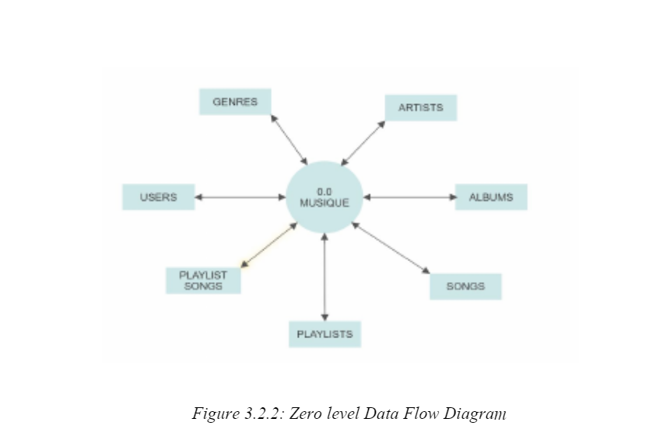
DATA FLOW DIAGRAM
Music
With Us

Slide 10
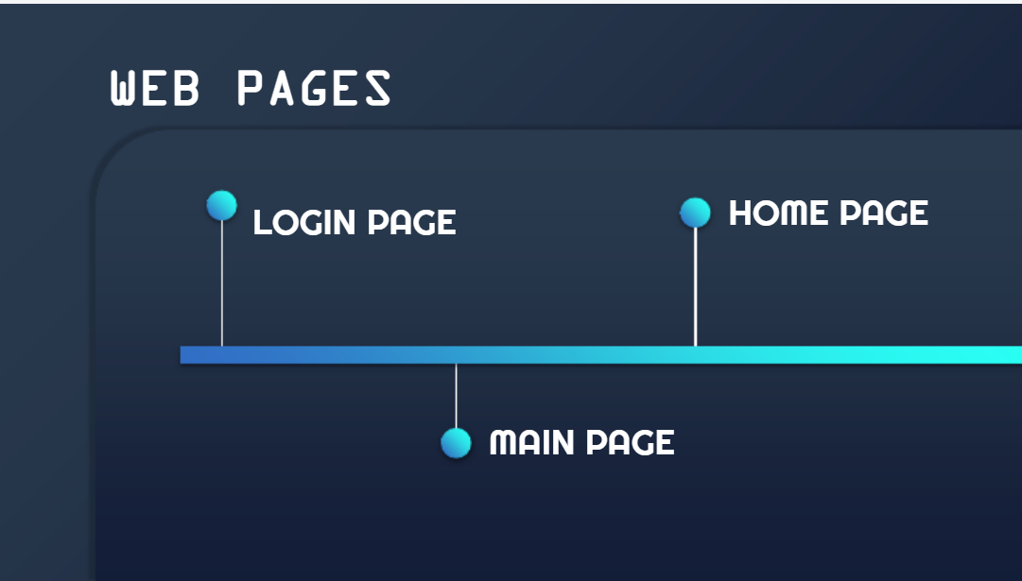
GLIMPSE

Slide 11






Versatility
Purchase Songs
We have provided a ample amount of songs,based on different moods and choices.You can select your favourites.
This facility is undergoing some construction.Stay connected for future updates!!
Registration
Good Interface
steps
Project
services
teams
Fill the Login Form to become a lifetime customer.We will try our best to assist you.
Users can chose songs of their choice and can have fun listening these melodious songs.
timeline
main
Create Your own music
Contact Us
Very soon we will be providing the facility to the users using which users can post their own songs and get fame.
You can reach us 24X7 for any query.
given below is the mail
prashant.kaushik_cs20@gla.ac.in

Slide 12
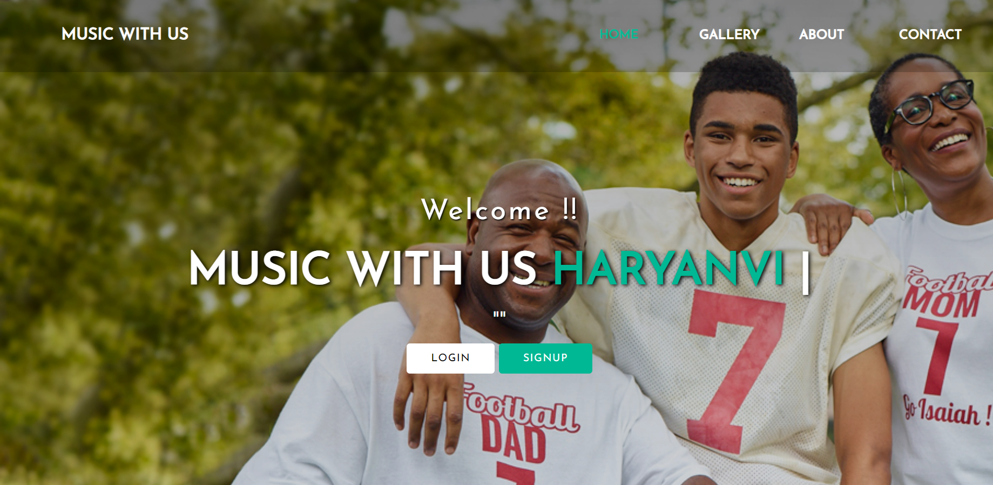

Slide 13
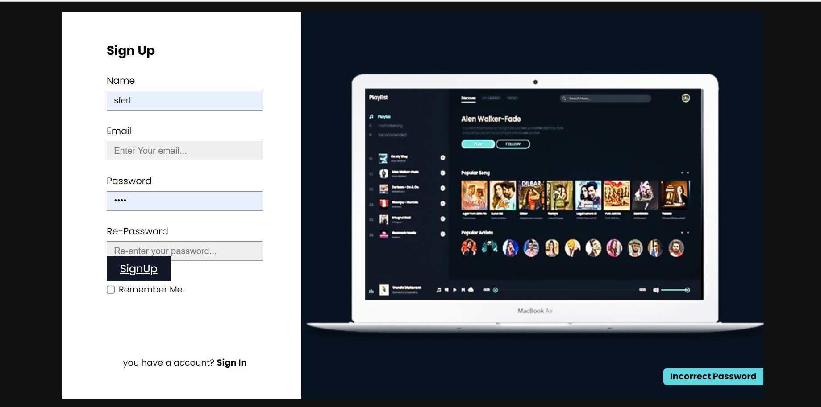

Slide 14
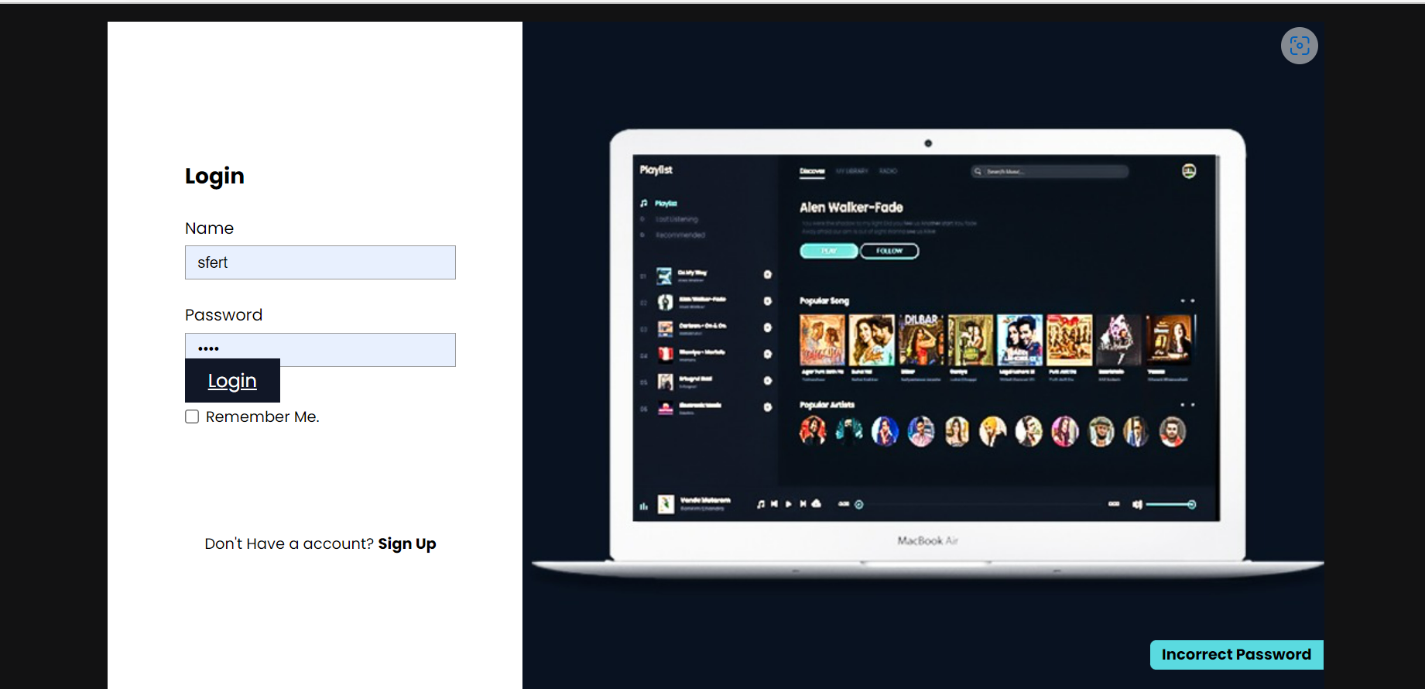

Slide 15
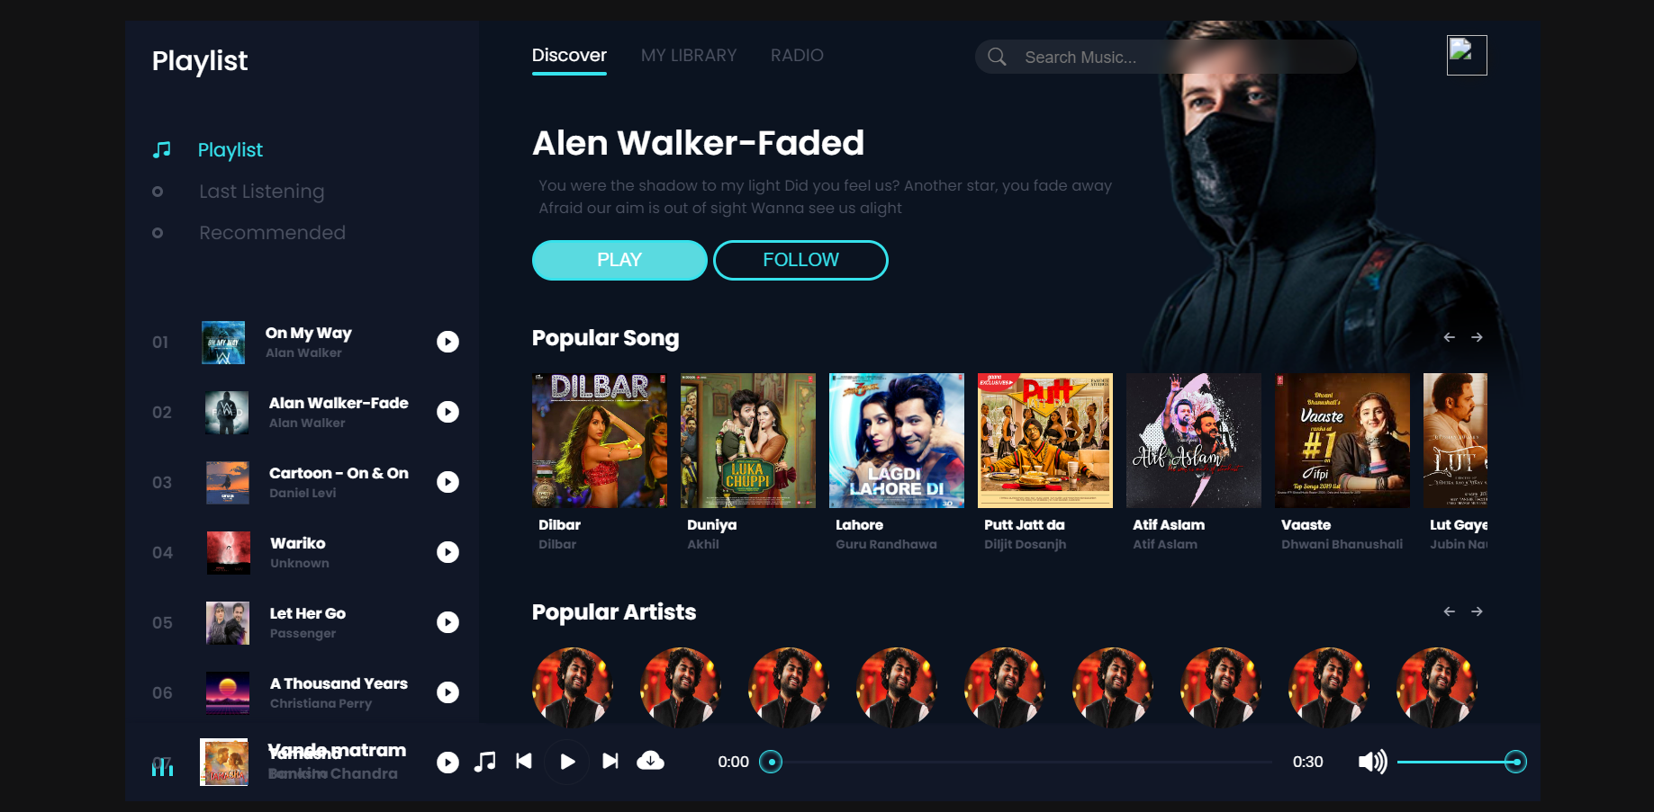

Slide 16
THANK YOU !!

